Slide 1
Oct,2020
Biomedical Committee – Biomedical Equipment Starter Pack
Session (3) : MRI
Prepared by: Mohamed Ahmed Abdelaziz

Slide 2
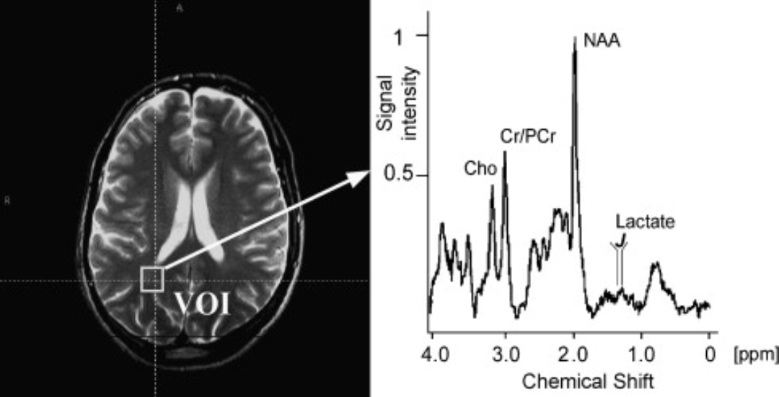
MRI History
1946
1950
1960
1974
1977
Felix Bloch
Theories were verified
experimentally
Magnetic Resonance Spectroscopy
Raymond Damdians
First super conducting MRI
Nobel prize for discovering new prosperities of the atomic nucleus
Biochemical changes & Metabolites frequency in the body.
Academic and Industrial research
First NMR of rat tumor

Slide 3
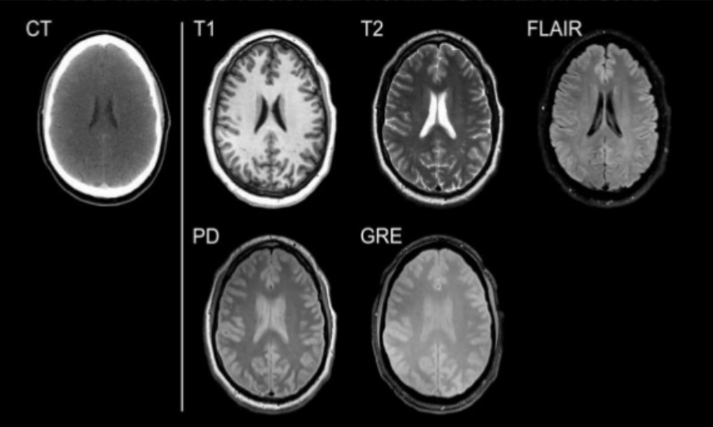
Why MRI ?
X-ray and CT contrast is poor compared to MRI.
X-ray and CT use ionized radiation.
Contrast medium in MRI has less side effects.
MRI could be optimized for certain pathologies.
MRI can acquire images in any imaginable plane.
Advanced techniques for imaging such as FMRI, Diffusion, Perfusion, and Spectroscopy

Slide 4
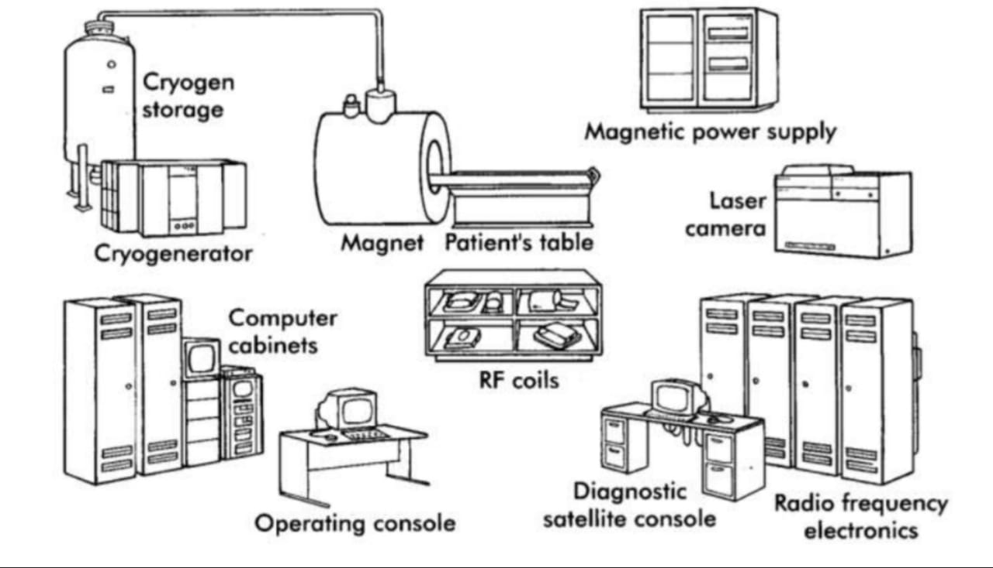
Hardware

Slide 5
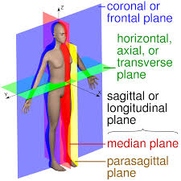
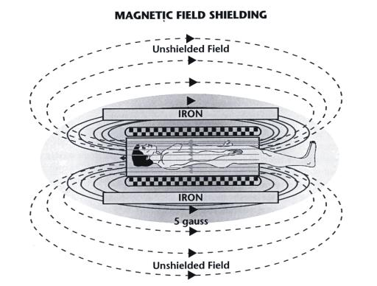
Magnetic Field

Slide 6
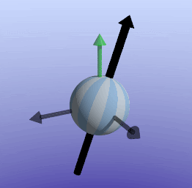
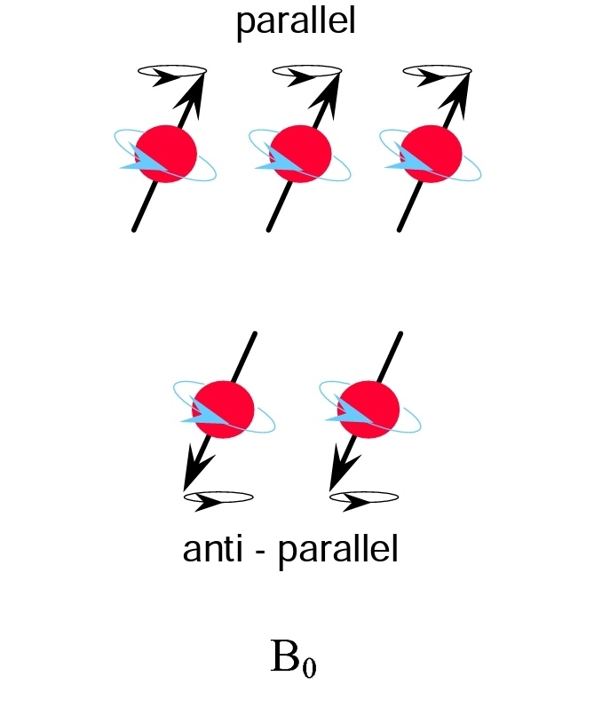
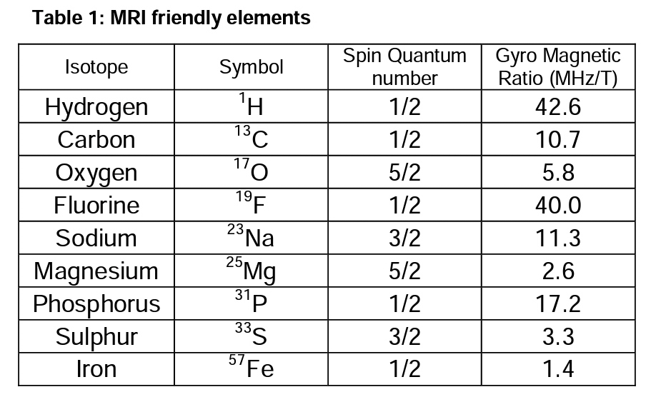
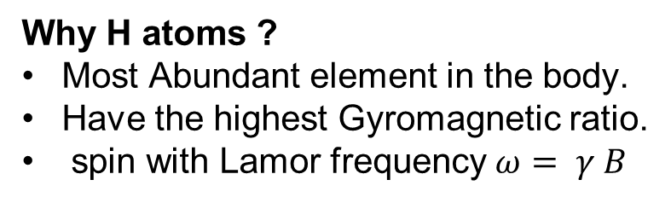
Magnetization
Why H atoms ?
Most Abundant element in the body.
Have the highest Gyromagnetic ratio.
spin with Lamor frequency$ω= γ B$
MRI Friendly elements

Slide 7
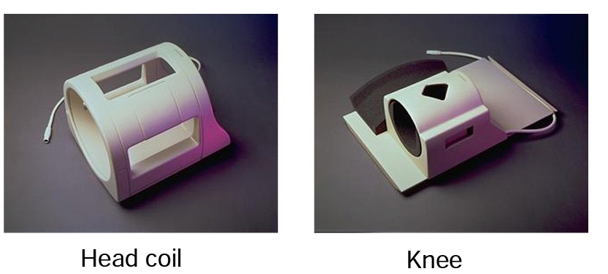
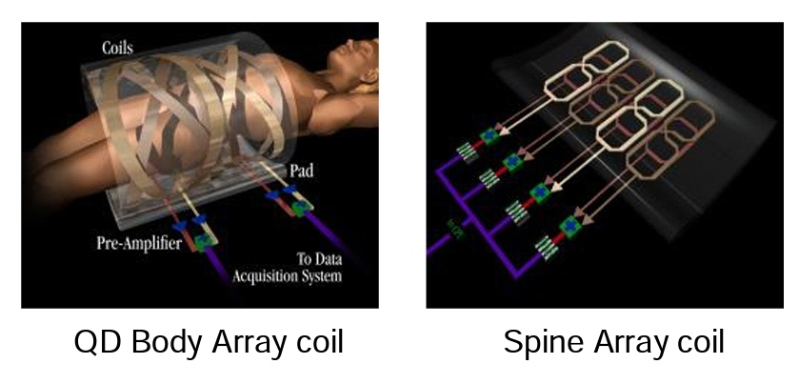
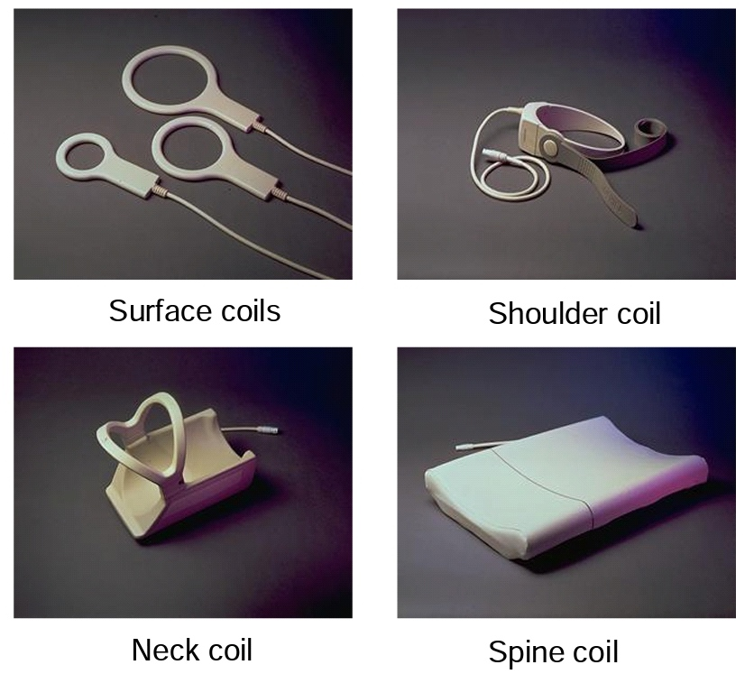
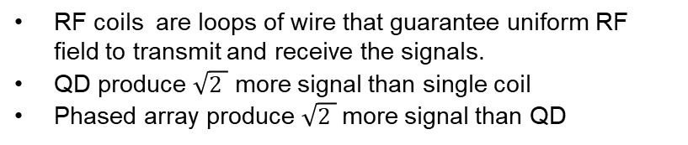
RF Coils
Volume Coils
Phased Array and Quadrature Coils
Surface Coils
RF coils are loops of wire that guarantee uniform RF field to transmit and receive the signals.
QD produce $\sqrt{2 }$ more signal than single coil
Phased array produce $\sqrt{2 }$more signal than QD

Slide 8
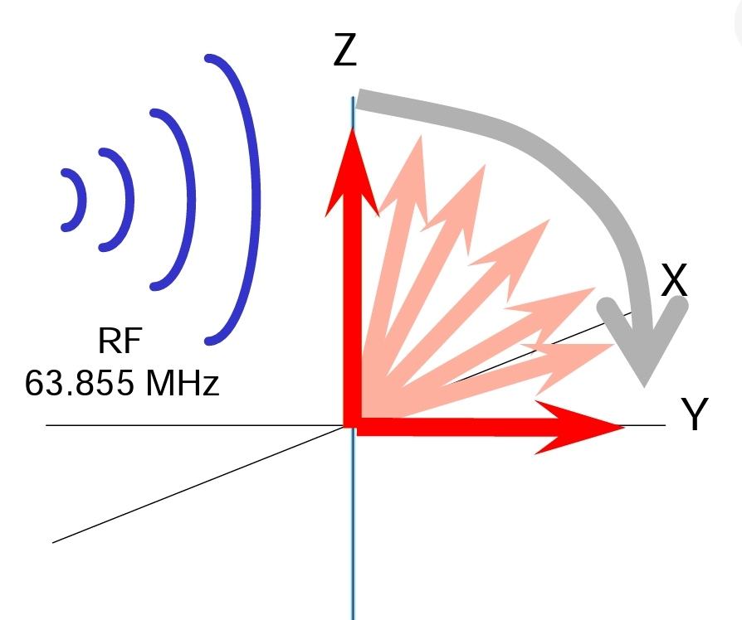
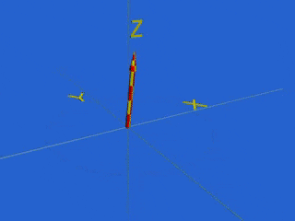
Excitation

Slide 9
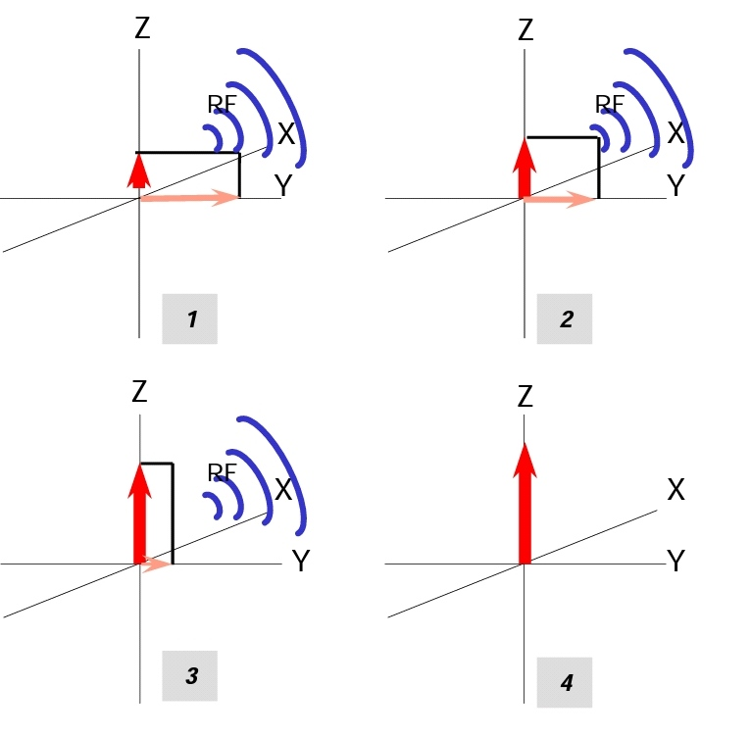
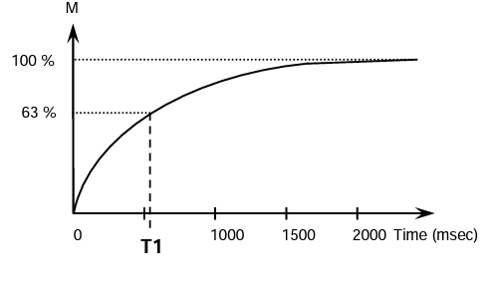
T1 Relaxation

Slide 10
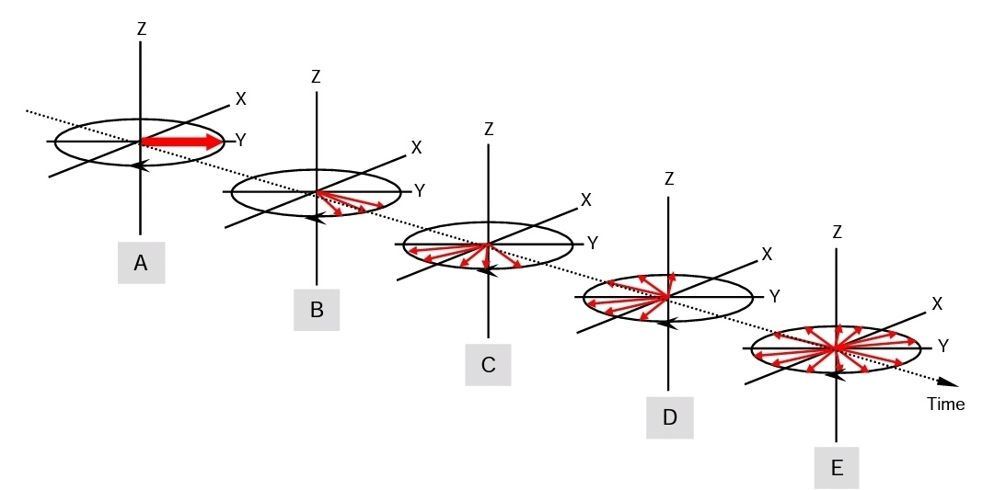
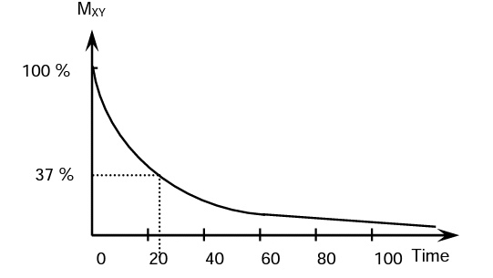
T2 Relaxation

Slide 11
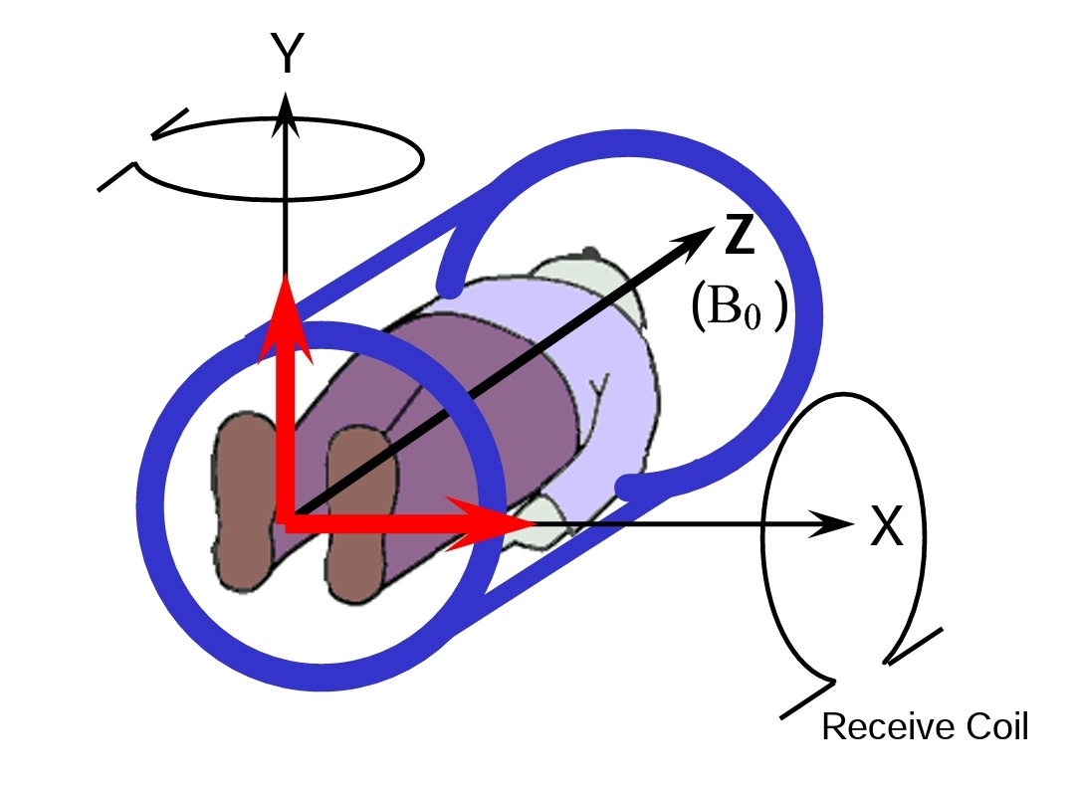
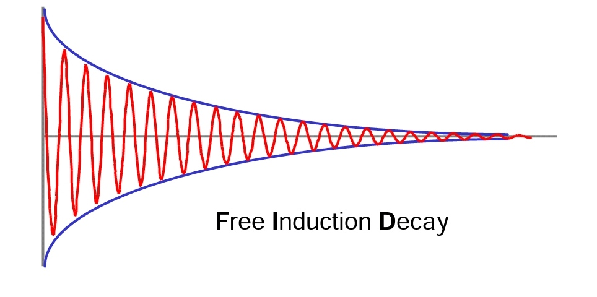
Acquisition

Slide 12
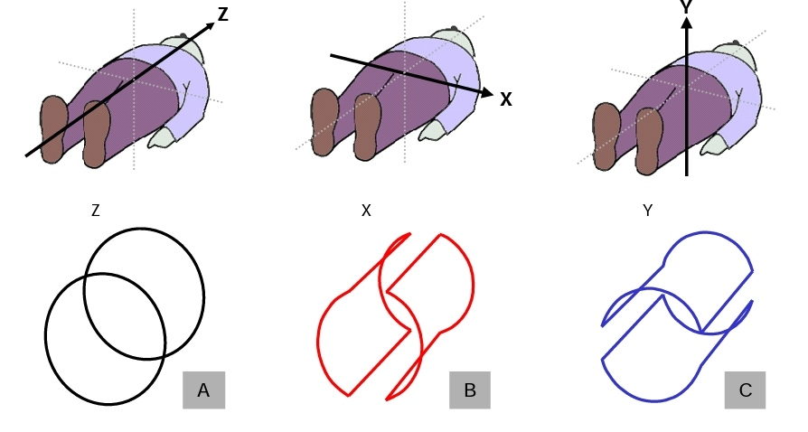
Gradient Coils
What makes noise in MRI ?

Slide 13
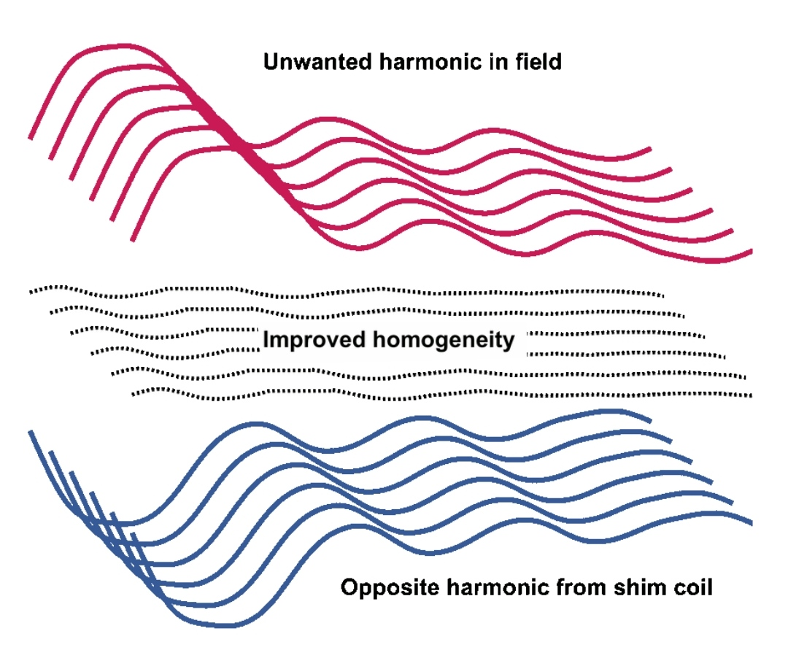
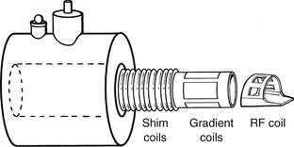
Shim Coils

Slide 14
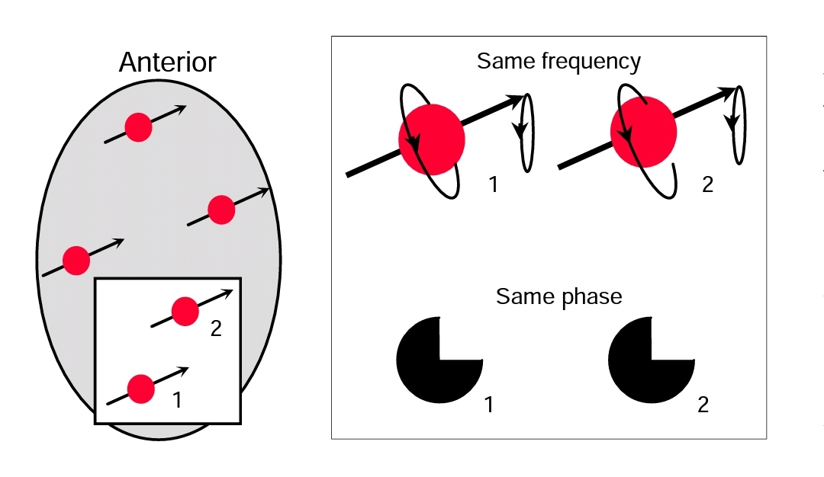
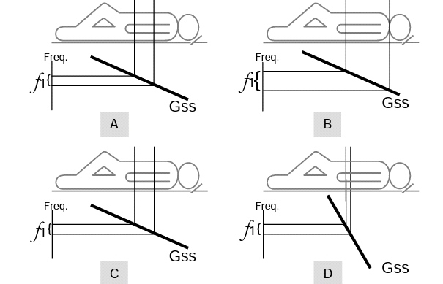
Slice encoding & Slice Thickness

Slide 15
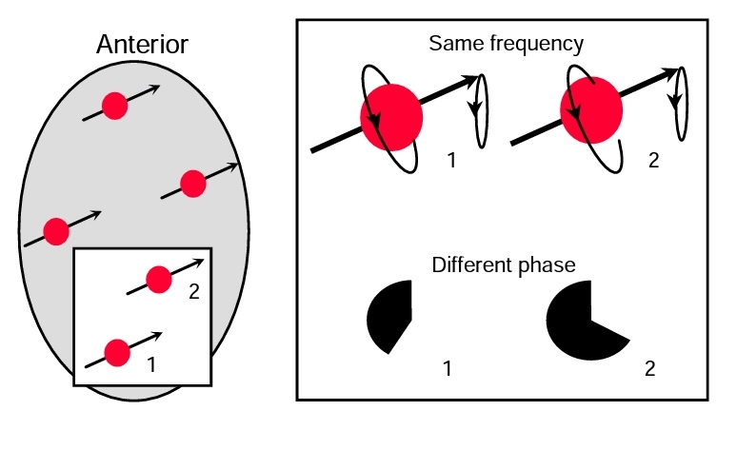
Phase Encoding
One row at a time. Anterior protons spin faster.

Slide 16
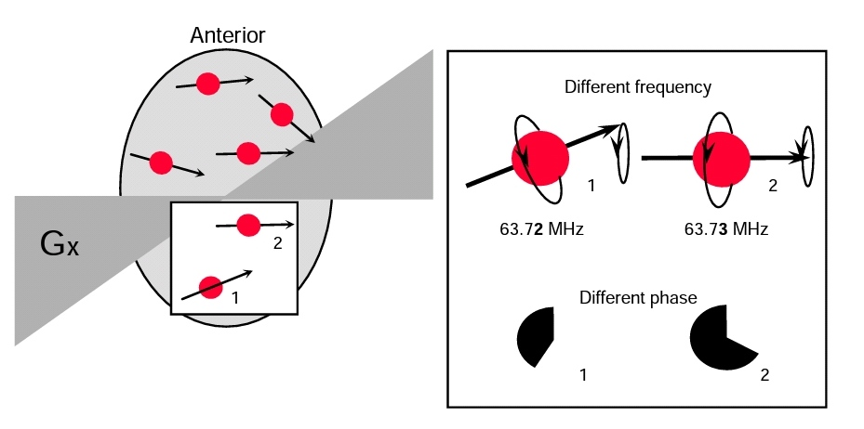
Frequency Encoding
Left protons spin with lower frequency

Slide 17
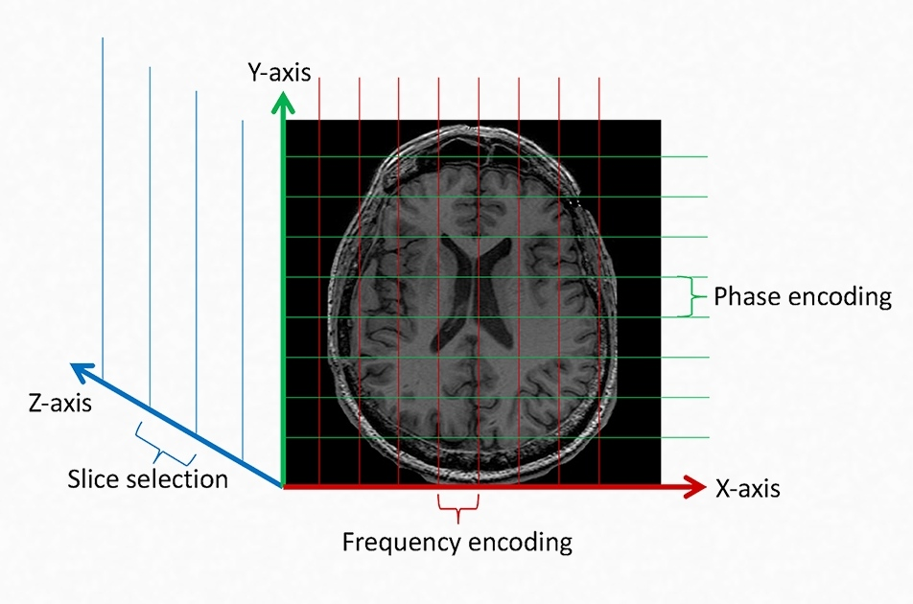

Slide 18
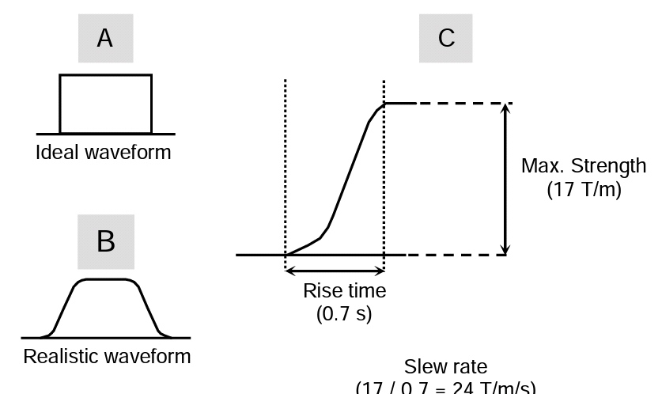
Gradient Specification

Slide 19
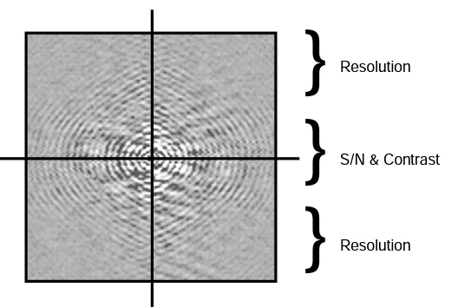
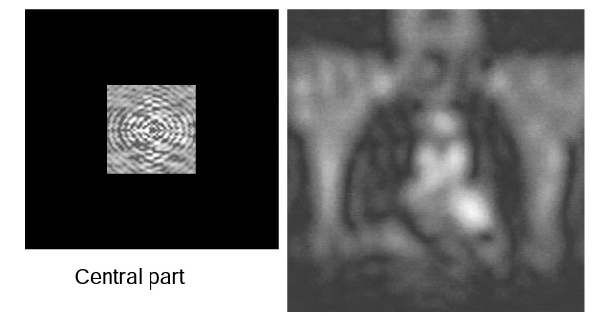
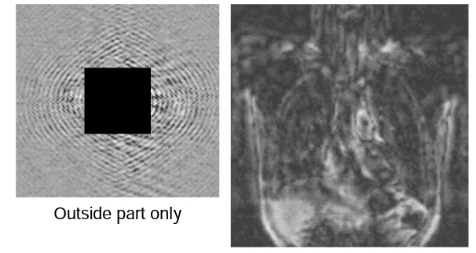
Task 1 (K-space)

Slide 20
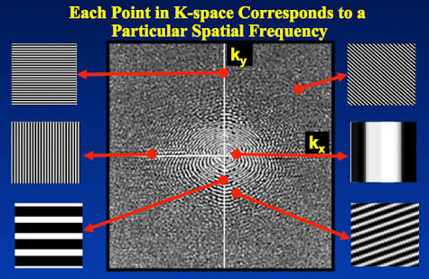
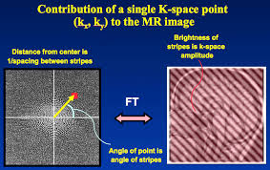

Slide 21
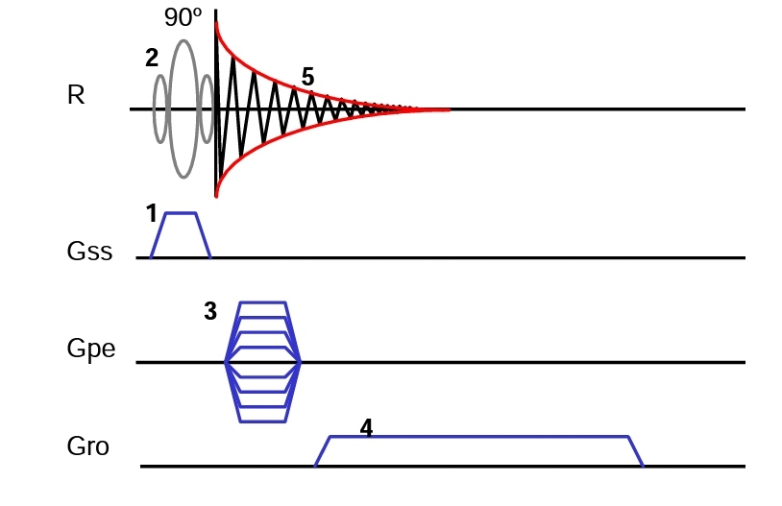
Pulse Sequences

Slide 22
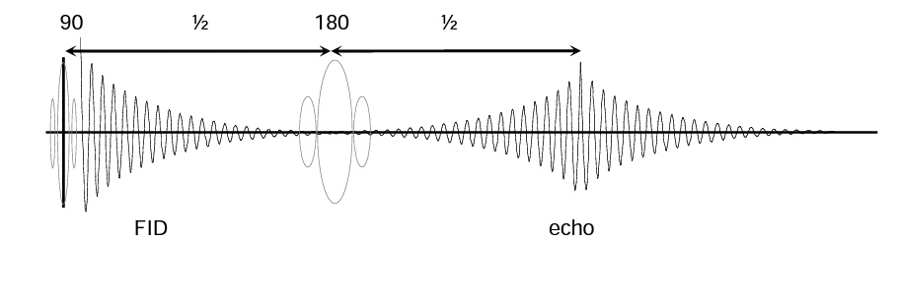
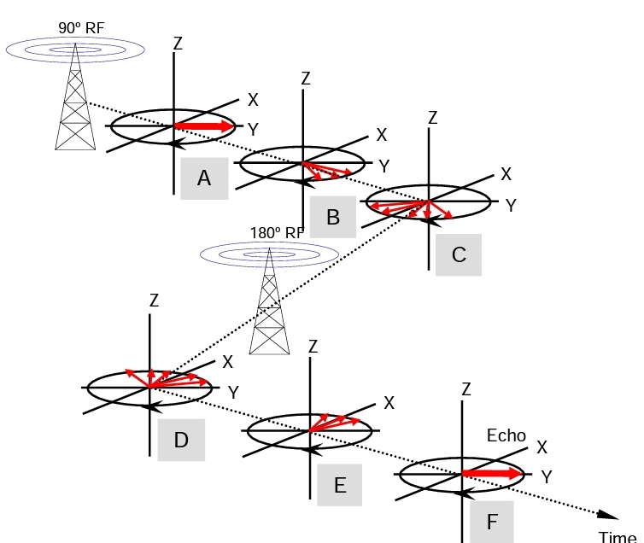
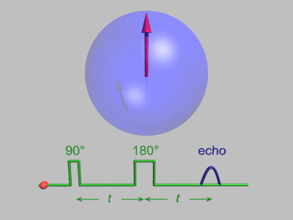
Spin Echo

Slide 23
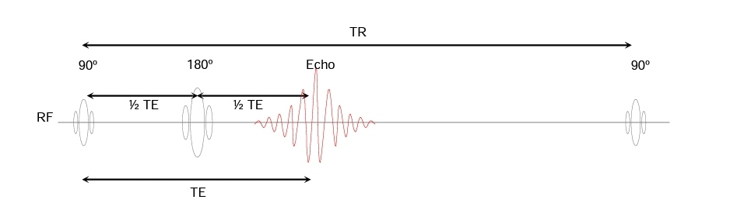
Sequence parameters
Repetition time : is the time between two excitation pulses
Echo time : is the time between excitation pulse and the echo(may occur due to gradient reversal)

Slide 24
Task 2
Multi Slicing Sequence
Multi Echo Sequence
Turbo Spin Echo Sequence
Fast Advanced Spin Echo Sequence

Slide 25
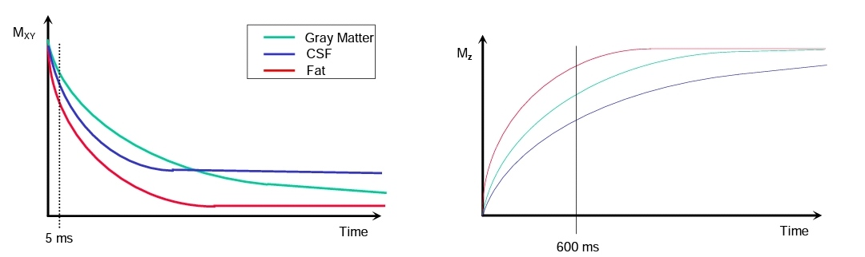
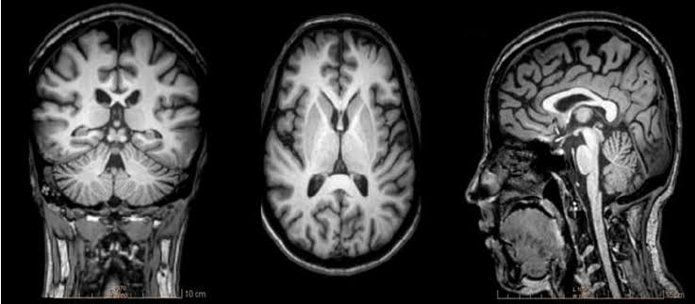
T1 Weighted Image
Short TE : no dephasing yet
Long TR : not all tissues have relaxed due to different bounding forces so we can
Differentiate between the tissues.

Slide 26
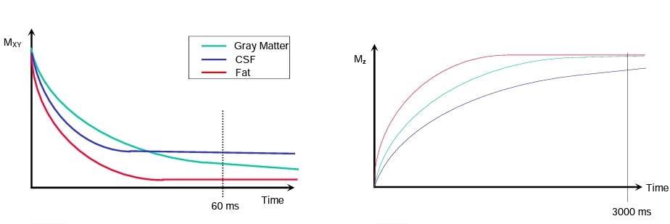
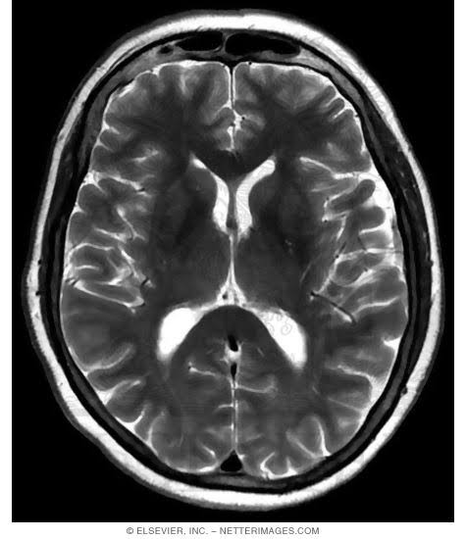
T2 Weighted Image
Long TE : most of the tissues that dephased will not produce a signal. Only tissues that
has some coherence will be bright.
Long TR : most of the tissues relaxed and will not affect the contrast

Slide 27
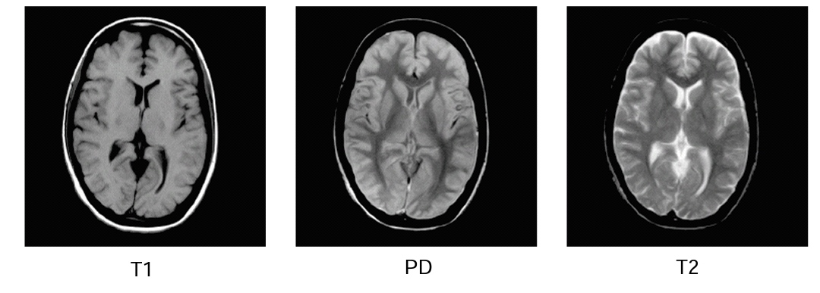
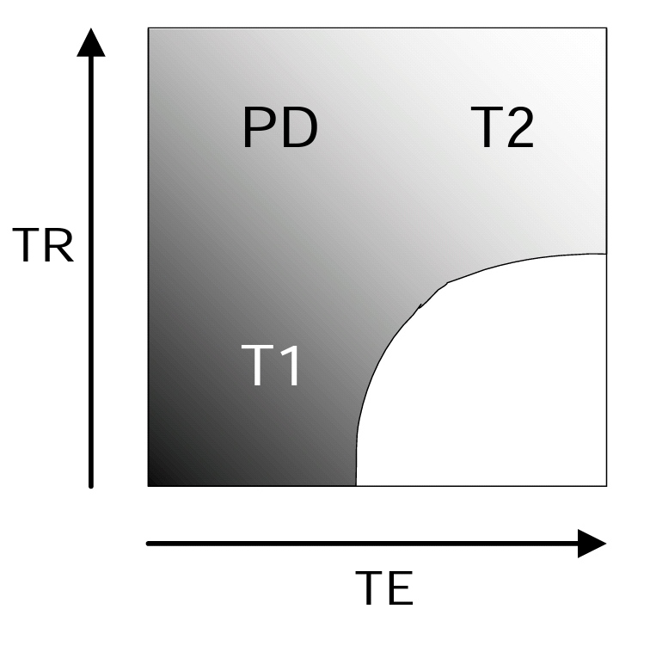
PD Image
Short TE : no T2 contrast
Long TR : no T1 contrast
Only the number of protons in each voxel will affect the signal

Slide 28
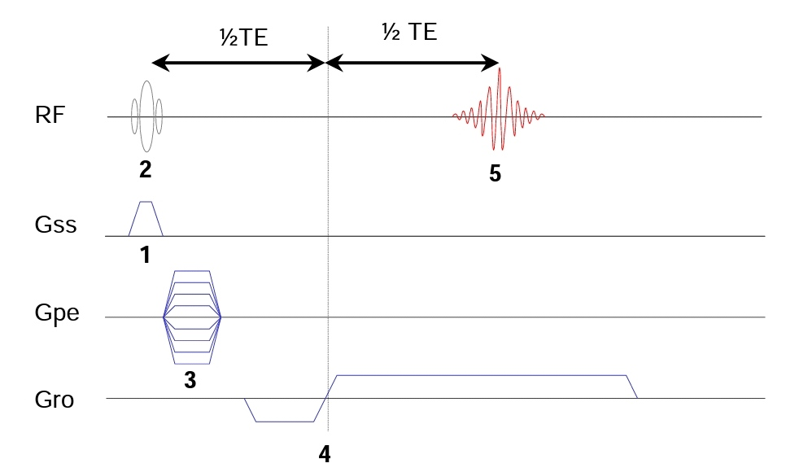
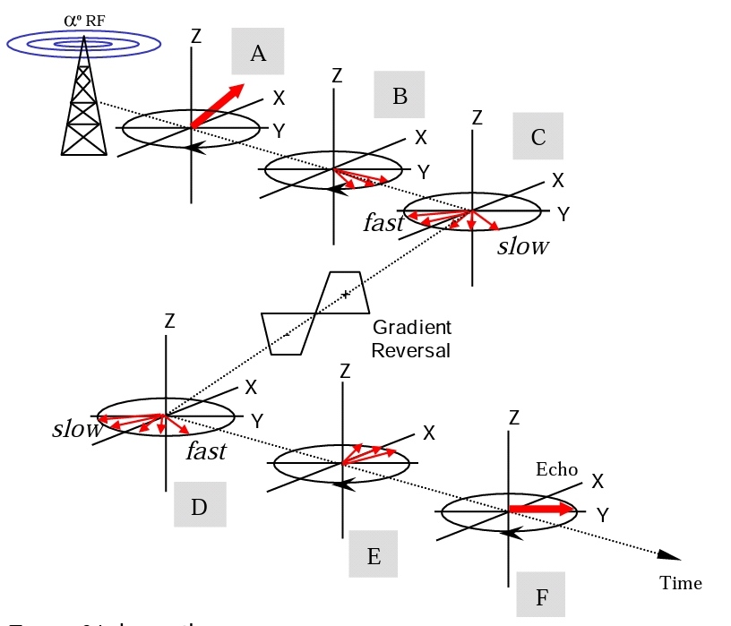
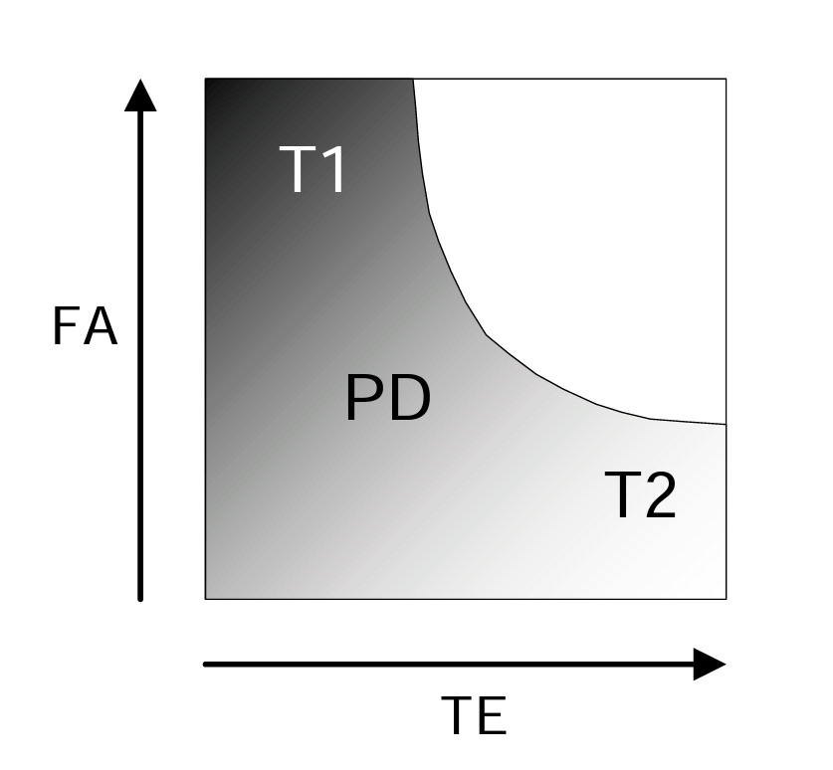
Gradient Echo Sequence

Slide 29
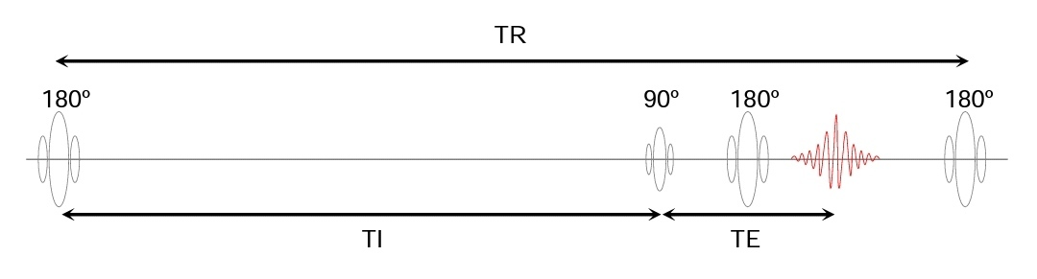


Inversion Recovery Sequence

Slide 30



Sequence Parameters
Repetition Time, TR
Echo Time, TE
Flip Angel, FA
More PD contrast
Increase scan time
More magnetization for next excitation
More T2 contrast
More dephasing , less signal
Possible contrast swap
More T1 contrast
More signal
Possible contrast swap

Slide 31



Matrix
Inversion time, TI
Number of Acquisitions, NEX
T1 contrast change
more signal
More signal sqrt(NA)
Less noise, fewer artifacts
Longer scan time
Lower signal, small voxel
Higher spatial resolution
Increase scan time

Slide 32



Slice Thickness, ST
Slice Gap, SG
Field Of View, FOV
Increase voxel size
Lower spatial resolution
Increase viewing area
Increase voxel size
Lower resolution
Larger object coverage
MX, FOV, ST determine the spatial resolution
Less cross talk
Increase coverage
Interleaving mode 1,3,5,…
2,4,6,…

Slide 33
Task 3
Parameters
Phase Echo Direction
Bandwidth

Slide 34






Image Artifacts
Motion Artifact
Para-magnetic Artifact
Phase Wrap Artifact
Frequency Artifact
Susceptibility Artifact
Clipping Artifact

Slide 35


Spike Artifact
Zebra Artifact

Slide 36
Common Failures
Coil Repair 4500 -6500 $
Gradient Amplifier 10000 – 12000 $
Mouse, Keyboard, And SCSI Driver 1200 – 1500 $
Cold Head 5000 – 9000 $ “ Re-condencing”

Slide 37
Task 4
Chemical Shift Artifact
STIR
FLAIR

Slide 38

Effect Of The Environment on MRI

Slide 39

Effect Of MRI On The Environment

Slide 40


MRI Shielding

Slide 41


Advanced MRI Techniques

Slide 42
Mohamed Ahmed Abdelaziz
Systems And Biomedical
Engineering Department
3rd Year
Cairo University
(+20)01552516133
Mohamed.ahmed997@eng-st.cu.edu.eg

Slide 43
Thanks

